Slide 1

DATABASE MANAGEMENT SYSTEMS
Project made by -
RAGHAV PATIDAR
RAKSHIT GOEL
RITESH BHANDARIA
This Photo by Unknown author is licensed under CC BY.

Slide 2

PROJECT DESCRIPTION
PROJECT NAME- PG STUDENT DATABASE
Basic overview of this project-
This project is made to assist the academic work and manage students and their course material
Students can login and check their courses and material
Teachers can make courses and manage them
This Photo by Unknown author is licensed under CC BY.

Slide 3
Modules
1. login page
2. student dashboard
3. teacher dashboard

Slide 4

Login:
When anyone accesses the database they will first encounter the login page
If the user already has his data entered, he/she can simply enter the system (teacher and students to their respective dashboards)
If your data is not stored you can register yourself with your id/roll no.
This Photo by Unknown author is licensed under CC BY.

Slide 5
STUDENT FEATURES
The student can access the course attributes given by the teacher.
Student can also send files to the teacher
There is also a one way connection for this current time with the teacher
The attributes which are being discussed here are, for example class links, lectures, marksheets, credits etc.

Slide 6
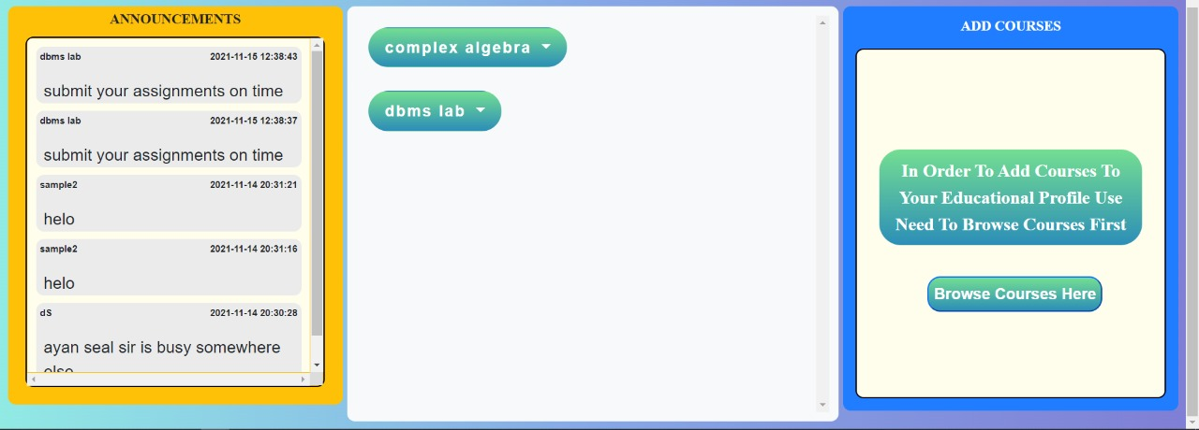
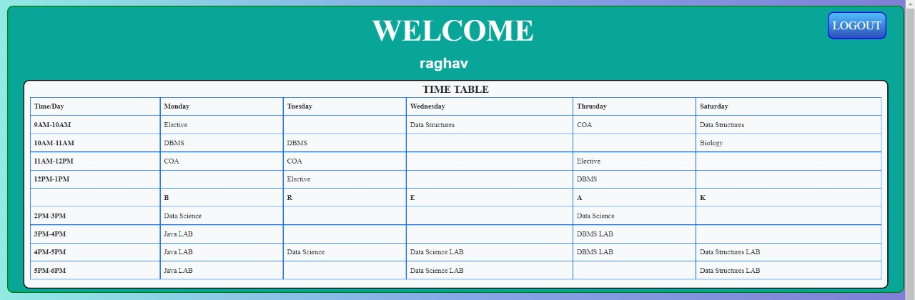
Student dashboard
In order to keep things simple we have made the dashboard very simple and easy to use
Simple display of notifications and courses is being made
The timeteble is made staic but still a relevat portion ofr students
Several links will be provided by the instructor for students to continue their courses

Slide 7
TEACHER FEATURES
Teacher can update old courses, create new courses, delete old courses
Teacher can add various attributes to the course as mentioned earlier.
Teacher can communicate with the students as discussed earlier in the previous slide, in a one way communication.

Slide 8
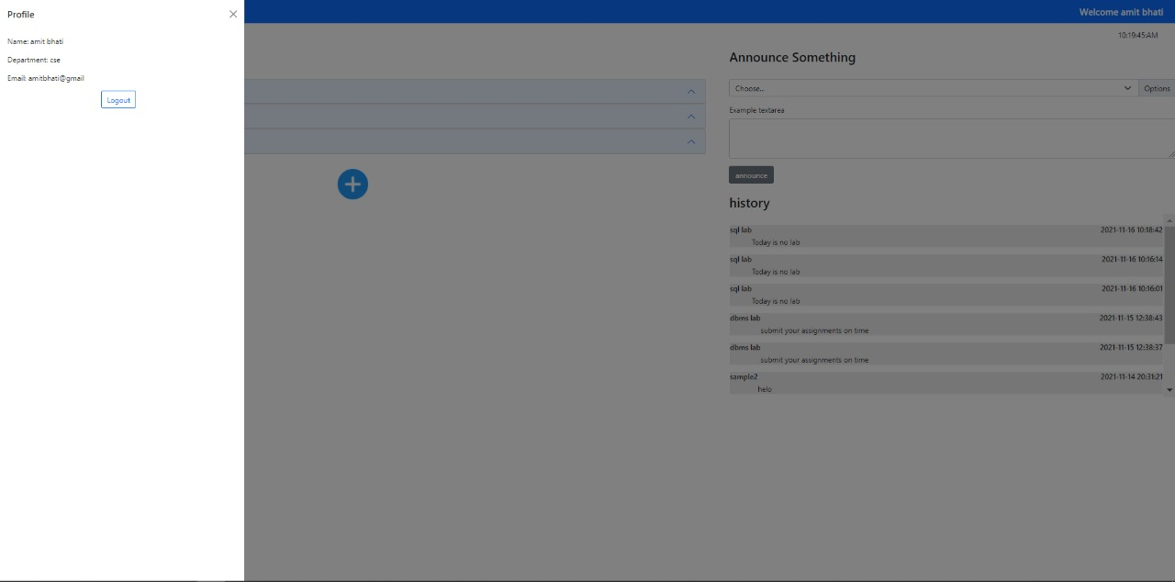
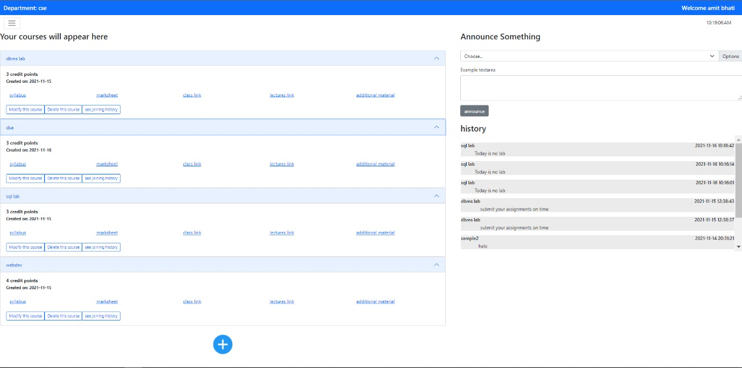
Teacher dashboard
A simple display is made to easily operateon the dashboard for easy navigation
A whole course creation and modification menu is made
An announcement section is also developed to contact with students

Slide 9






Technology stack
HTML
CSS
Bootstrap
PHP
My SQL
Javascript
This Photo by Unknown author is licensed under CC BY-SA.
This Photo by Unknown author is licensed under CC BY-SA.
This Photo by Unknown author is licensed under CC BY-NC.
This Photo by Unknown author is licensed under CC BY-SA.
This Photo by Unknown author is licensed under CC BY.
This Photo by Unknown author is licensed under CC BY.

Slide 10
